Slide 1





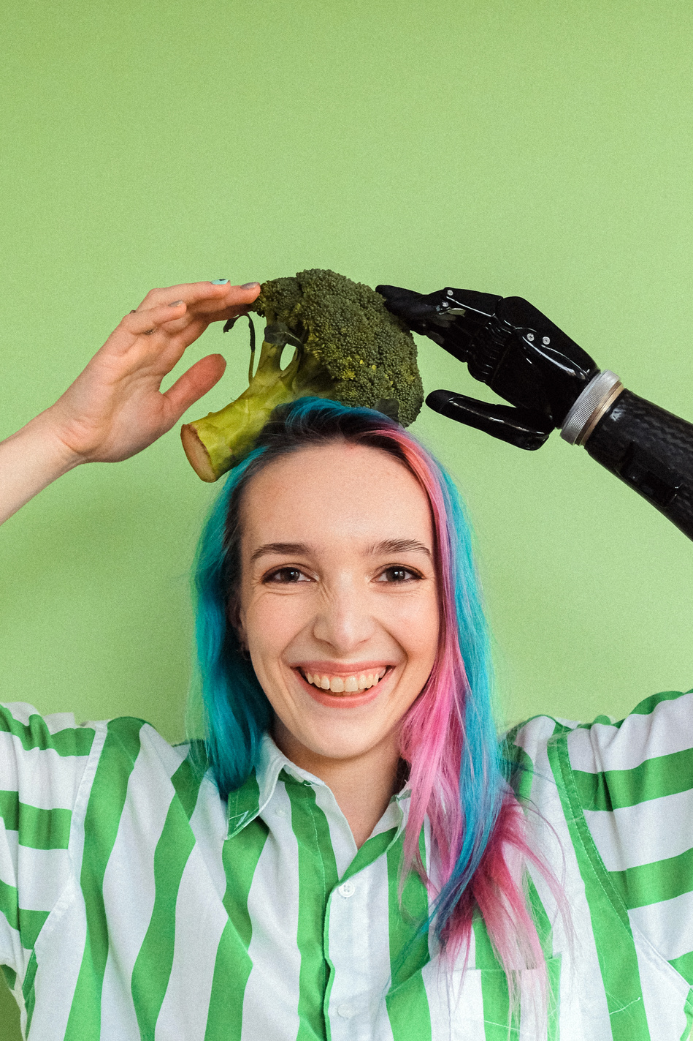


Notes:
Intro slide

Slide 2

Vision
Connecting people to share skills, knowledge, and help each other reduce feelings of loneliness in isolation

Slide 3
Skills and Knowledge
Learn and Connect
Millions of people with skills, knowledge and experience they want to share.
Millions of people wanting to learn or improve their skills but unable to do so in lockdown.
Be part of a community and connect with like-minded people

Slide 4
Proposition
Students
Tutors
Tutors
Have skills to share
Have spare time
Volunteers or professionals
May offer free and paid services
Want to learn or practise skills
Need assistance with a problem
Want to share common interests
Individuals or small groups
Utilize existing skills while in isolation
Human-to-human interaction
Establish new connections
Potential to develop revenue stream
Notes:
Need to update to 'value proposition/solution benefits statement'

Slide 5




The Solution
Tutor Profile
Find a Tutor
Connect
Share
Notes:
Need to update to 'growth opportunities'

Slide 6


Art
Social
Learn arts and craft one-on-one or in small groups.
Find people to talk to when feeling lonely.
Home Improvement
Languages
Find people to learn and practise a new language with.
Get assistance in DIY, gardening or auto repairs.

Slide 7

SocialCollab Demonstration

Slide 8
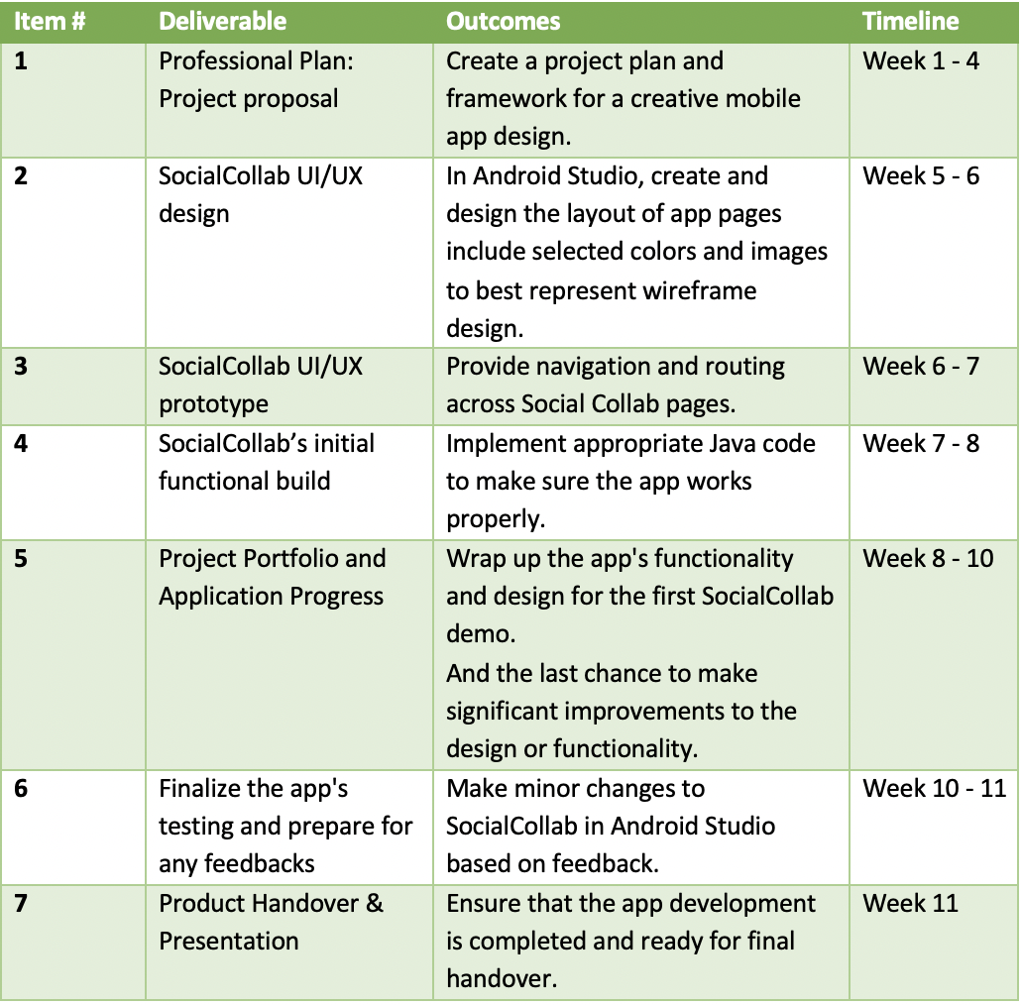
Milestones of Project Plan
Development Process

Slide 9
Key Features
SocialCollab’s Navigation
Login and Register Account using Firestore Database
Chat System Feature Using Firestore Database
Audio and Video conference - Firebase Authentication Database
Notes:
Need to update to 'growth opportunities'

Slide 10
Obstacle and Challenge
Determine whether it will be a single activity with child fragments or a collection of interacting activities.
Integrating SocialCollab and Firebase's databases was a challenging task.
Creating dynamic displays for recyclers was another obstacle.
A further challenge was developing video conferencing on the Jitsi Meet platform.

Slide 11



People Helping People
Notes:
Concluding statement(s)

